Slide 1
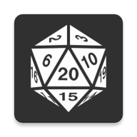
Custom Dice Roller
By
Weston Fiala

Slide 2
Goal
Create an app that I would want to use
Minimally viable in 2 development weeks
Fulfills the criteria for a good grade

Slide 3
Necessary Features
Cover the standard RPG dice rolls
d4, d6, d8, d10, d12, d20, and d100
Roll more than one dice at a time
Add a modifier to the results of the dice

Slide 4
Additional Features
Shake the phone to roll the dice
Visually show the dice bouncing around the screen
Keep a history of all the rolls in the current session
User settings around the shake feature

Slide 5
What Does it Look like?

Slide 6
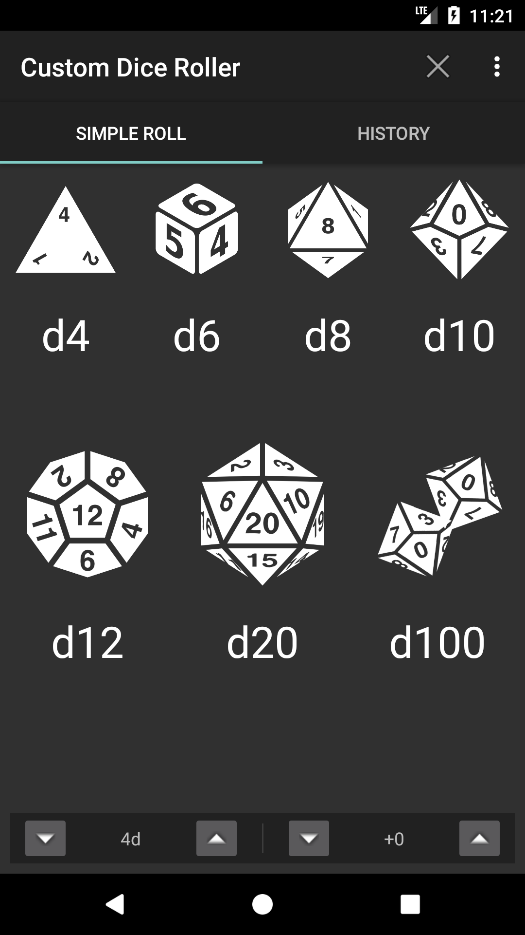
Main Screen
Dark theme look with few color variations
Recognizable icons for each die and a label below each
Buttons for controlling number of die and modifier to be added to roll

Slide 7
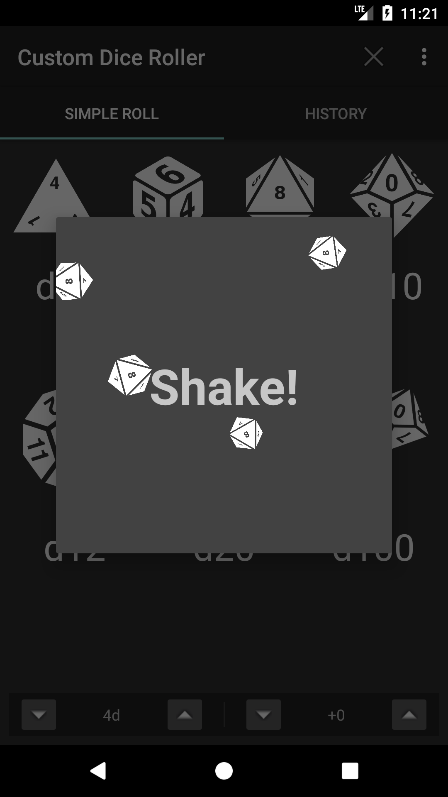
In Action!
Dialog appears on screen with bouncing and spinning dice
Message in the middle of the dialog telling the user to shake
After a settable duration of shaking, a hold still message appears

Slide 8
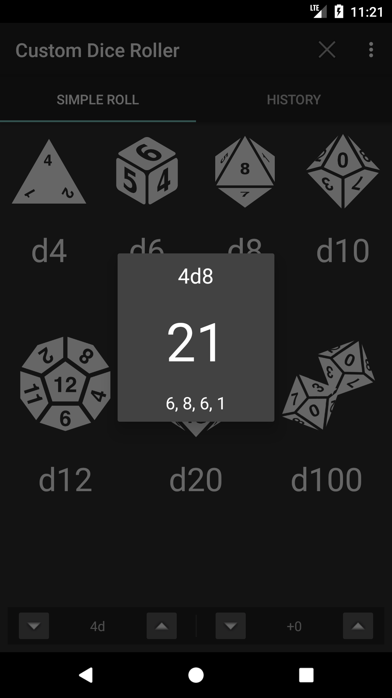
Results
Once the user stops shaking, a new dialog shows up
The roll total is displayed in the center to relay the most important info
Detailed breakdown is available below the total

Slide 9
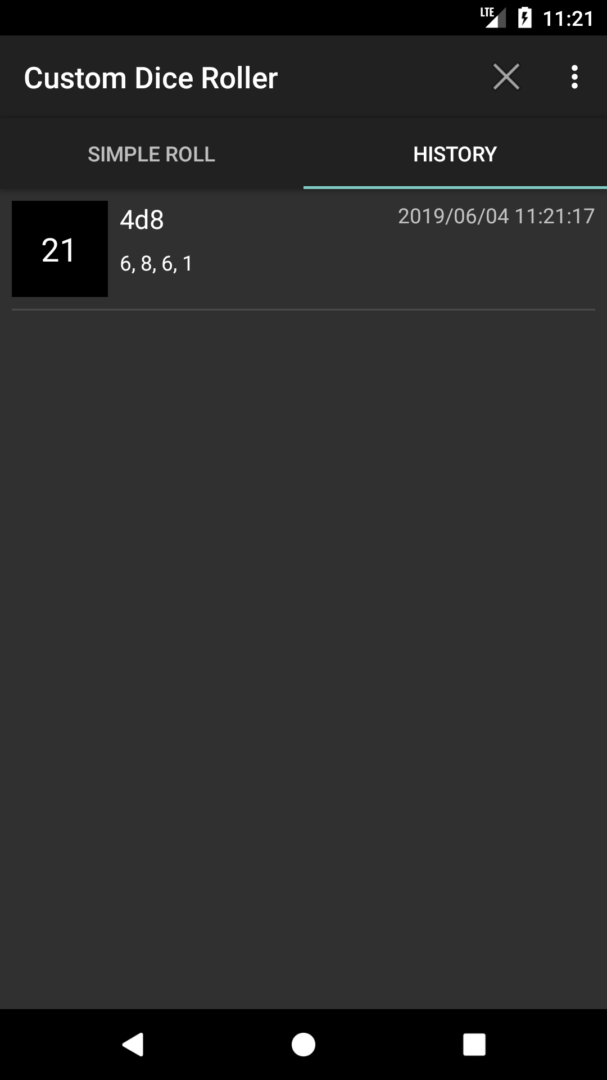
What did I just roll?
Swipe to the left to move to the history tab and see what you just got
Newer rolls are appended to the beginning
Able to clear the history by clicking the “X” in the upper right

Slide 10
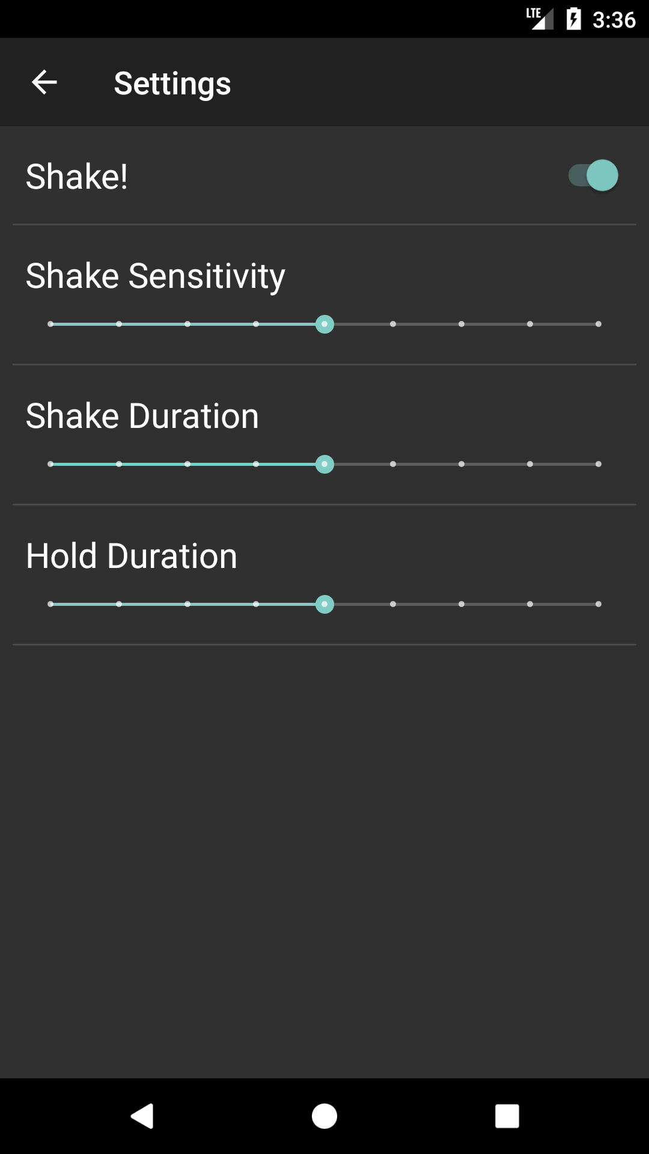
I don’t like shaking it
Able to turn off and on the shake feature
Adjust the sensitivity, shake duration, and hold duration by slider
When shake is off, no shake dialog appears

Slide 11
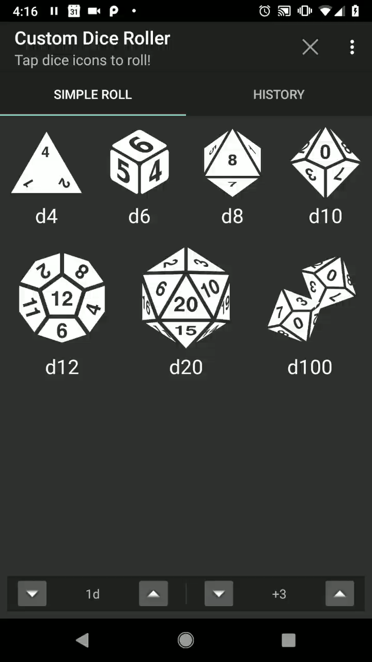
Demo Time!
Shake to roll a d20
Increase the number of dice and roll some d6s
Check the history, and then clear it

Slide 12
Try it out yourself!
I published the app to the app store!
https://play.google.com/store/apps/details?id=com.fialasfiasco.customdiceroller
Search “pub:Weston Fiala” on the Play Store
Or search “com.fialasfiasco.customdiceroller

Slide 13
Future Features
Arbitrary dice rolls outside of standard set
d32, d1001, ….
Roll different dice at once
d20 and a d4 at once and show the result
Play a sound every time a dice bounces back from an edge
Allow for color tints on the dice to help distinguish different rolls

